Slide 1

Alert Watch and Response Engine (AWARE)
Knowledge Base (KB) Editor Training
Ralph H Johnson VA Medical Center
Charleston, SC
June 2014 CLIN 0009AC

Slide 2
Contents
Lesson 1: What Is the KB Editor?
Overview and Requirements
Lesson 2: Accessing the KB Editor
Logging In and Out
Viewing Existing Alert Categories/Types
Navigating Through the KB Editor
Sorting Alert Categories/Types
Lesson 3: Configuring Alert Categories/Types
Alert Categories
Alert Types
Adding Alert Types
The Reminder Dialog
The Order Dialog
The Follow-up Dialog
The Comments Dialog
Making Alerts Active
Editing Alert Types
Deleting Alert Types
Contact Information

Slide 3
Purpose and Objectives
Objective: To provide an overview, basic training, and examples of how to access and use the KB Editor
After completing this training:
All Users should be able to access the KB Editor, view alert categories, and add/edit/delete alert types

Slide 4
Lesson 1: What is the KB Editor?

Slide 5
Overview and Requirements
The KB Editor is a web application for creating alert categories and types, and for setting business rules. It is used for customizing alerts for a given VA installation.
Primary users:
Clinical Application Coordinators (CACs)
Knowledge of Reminder Dialogs, Text Integration Utilities (TIU), and Health Factors design is essential.
To be able to add or modify rules in the KB Editor, the user must own the VEFA AWARE ADD/EDIT RULE VistA security key.

Slide 6
Overview and Requirements
The KB Editor allows you to create multiple alert categories and multiple alert types within each alert category.
Alert categories must be made first, before defining the alert types within the category.
To create alert categories, a programmer security key is required.
Knowledge Base Editor (KB Editor)
Alert Category 1 (e.g., Critical Labs)
Prostate Specific Antigen (PSA)
Fecal Occult Blood Test (FOBT)
Alert Category 2 (e.g., Abnormal Imaging)
Mammogram
Chest X-ray
KB Editor Structure Example

Slide 7
Lesson 2: Accessing the KB Editor

Slide 8
Logging in and Out

Slide 9
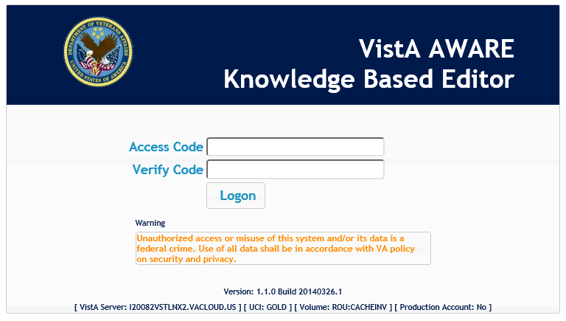
Logging In
Open a web browser and navigate to [URL].
You should then see the page below:
KB Editor Login Page

Slide 10
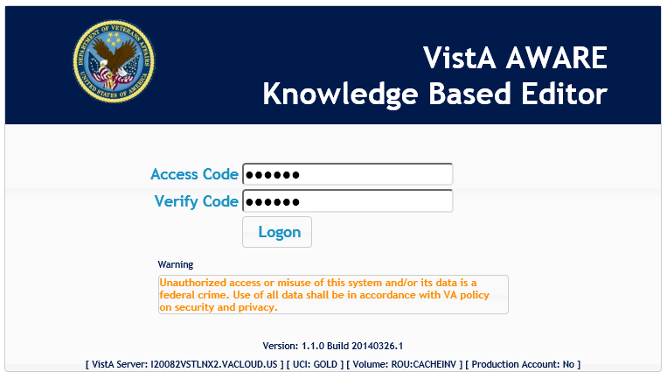
Logging In
Type your Access Code and Verify Code into the fields.
KB Editor Login Page

Slide 11
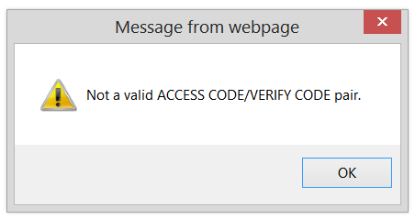
Logging In
Click Login.
Note: If your login information is incorrect, you will see the following message.
KB Editor Login Page

Slide 12
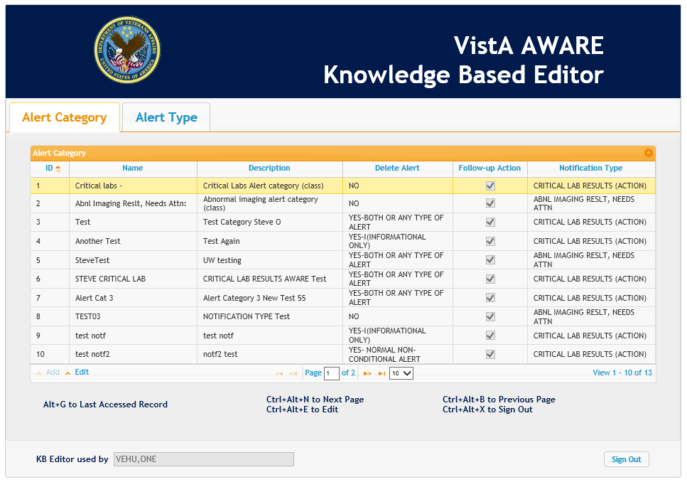
Logging In
Upon successfully logging in, you should see this page.
KB Editor Main Page

Slide 13
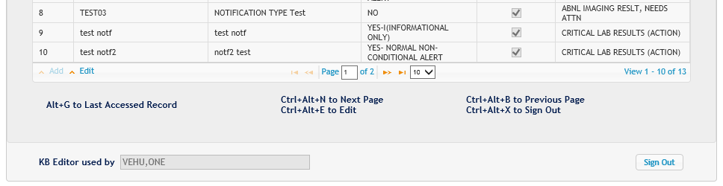
Logging Out
To log out, Click the Sign Out button in the bottom-right of the page or press Ctrl+Alt+X.
KB Editor Main Page

Slide 14
Viewing Alert Categories/Types

Slide 15
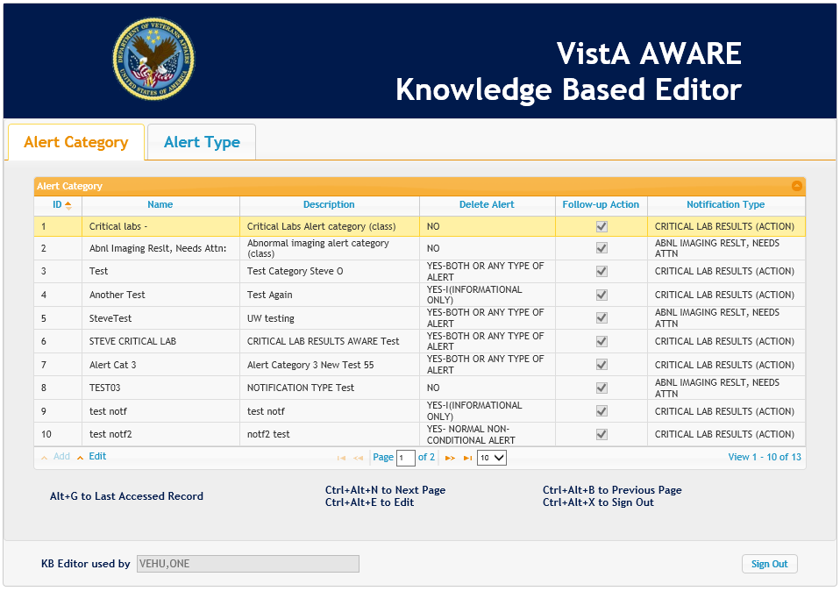
The KB Editor
The KB Editor shows lists of alert categories and alert types that have been created within each alert category.
Note: The alert categories and types shown here are for training purposes and those configured for your site may differ.
KB Editor Main Page

Slide 16
The KB Editor
The Alert Categories tab is shown first by default.
Click on the Alert Category or Alert Type tabs to switch between viewing alert categories or types.
KB Editor Main Page

Slide 17
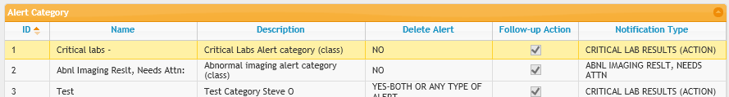
Understanding the Columns – Alert Category Tab
Each of the columns in the table shows information about the alert category in that row.
Identifies that an alert with this notification type will be tracked by AWARE
The name of the alert category
A description of the alert category
A numerical identifier assigned to the alert category
Indicates category may or may not be deleted
Indicates whether alerts of this category may be processed upon follow-up action
KB Editor Alert Category Columns

Slide 18
Understanding the Columns – Alert Category Tab
Name | Used to identify that an alert is tracked in AWARE (critical alerts).
Description | Free text field. This is the only field CACs can modify.
Delete Alert | Indicates the alert may or may not be deleted. “No” is the default value (does not allow deletion or acknowledgment of alert unless follow-up actions are made).
Upon Follow-up Action | A checked box (the default) indicates the alert may be processed upon follow-up action. Currently, this field is used for information only.
Notification Type | Used to identify that an alert with this notification type will be tracked by AWARE.
KB Editor Alert Category Column Descriptions

Slide 19
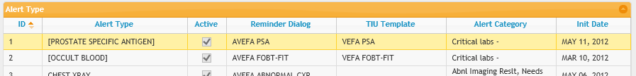
Understanding the Columns – Alert Type Tab
Each of the columns in the table shows information about the alert type in that row.
The name of the alert type
Indicates the reminder dialog used by this alert type
Indicates the corresponding alert category
Indicates whether the alert type is ready to be used
Indicates the TIU template used by this alert type
Indicates the date the alert type was first set to Active and tracking began in AWARE
A numerical identifier assigned to the alert type
KB Editor Alert Type Columns

Slide 20
Understanding the Columns – Alert Type Tab
Alert Type | Indicates the type of alert to be tracked by AWARE.
Description | Free text to describe the Alert Type.
Reminder Dialog | A pointer to the Reminder Dialog file. For An alert type to be tracked, it must have a Reminder Dialog value defined here.
TIU Template | A pointer to a TIU template connected to the Reminder Dialog. For an alert type to be tracked and followed-up in CPRS, it must have this TIU template. This template will be used by CPRS to generate follow-up notes.
Alert Category | Indicates the associated Alert Category, required for an alert type to be tracked.
Alert Type Mnemonic | A short representation of the Alert Type (typically the initials of the Alert Type’s name). The mnemonic is used to easily identify Reminder/Order dialogs and tie them to the Alert Type. This is a required field.
AWARE Source Site | The site number where the Alert Type was first created. This should be modified only if a user defines a new Alert type, in which case the user’s own site station number should be entered. This is a required field.
Active | Indicates that this Alert Type is ready to be used. Users may freely activate or deactivate this flag, but the user should not make this value “ACTIVE” until the Reminder Dialog has been completely designed and customized for a specific site including the defining and specification of any Order Dialog/Orderable items into the associated Reminder Dialog with the Alert type. Also, the Alert Type Validator may deactivate this flag when an error is found. The Validator will be invoked when the Alert type elements are saved.
Initiation Date | The date the alert type was set to Active.
KB Editor Alert Type Column Descriptions

Slide 21
The KB Editor Main Page
You can also:
Navigate between pages of alert categories/types and change how many are displayed on a page
Sort displayed alert categories/types in different orders
View and configure alert categories/types
Each of these functions will be explained in the subsequent slides.
Double-click on a row or press Ctrl-Alt-E with a row highlighted to view detailed information or configure an alert category or type.
This is explained further in Lesson 3: Configuring Alert Categories/Types.

Slide 22
Navigating Through THE KB Editor

Slide 23
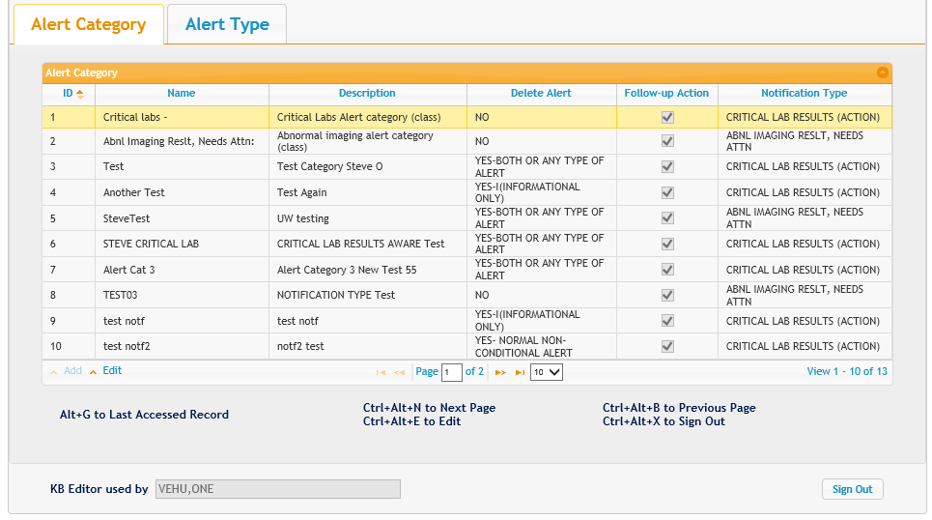
Navigation Controls
The navigation controls at the bottom of each page allow you to navigate between pages and change how much data is displayed on a page.
KB Editor Alert Categories Tab

Slide 24
Navigation Controls
Go to the first page of data
Go back one page
Type a number in this field and press Enter to move directly to that page
Go forward one page
Go to the last page of data
Click to display a dropdown to choose how many records are displayed on a page

Slide 25
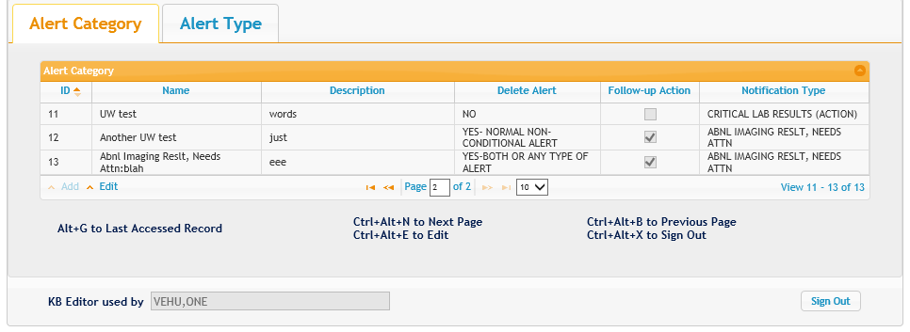
View Records Display
Text at the bottom of the screen shows which alert category/type records you are currently viewing.
For example, records 11-13 of 13 total records
KB Editor View Records Display

Slide 26
Sorting Alert Categories/Types

Slide 27
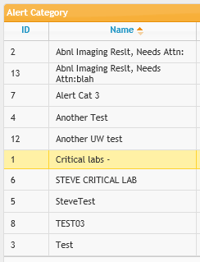
Sorting Data
Click on a column header to sort all of the data according to that column.
For example, alphabetically from A-Z.
Click on the same column header again to sort all data in the opposite direction.
For example, alphabetically from Z-A.
Data sorted alphabetically by alert category name

Slide 28
Lesson 3: Configuring Alert Categories/Types

Slide 29
Alert Categories

Slide 30
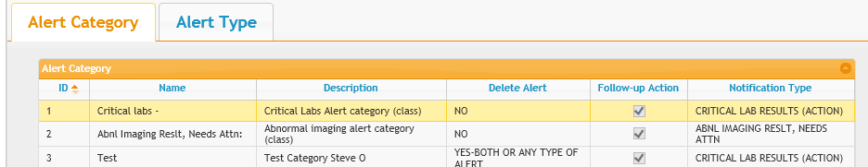
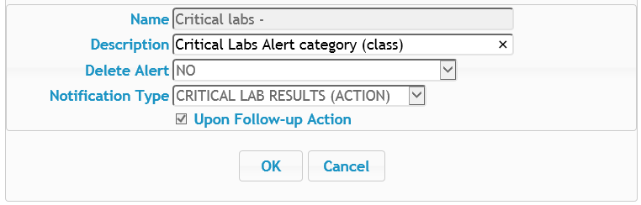
Alert Categories
Double-click on a row or press Ctrl+Alt+E with a row highlighted to view detailed information about an alert category
KB Editor View Alert Categories Tab
KB Editor Alert Category Details

Slide 31
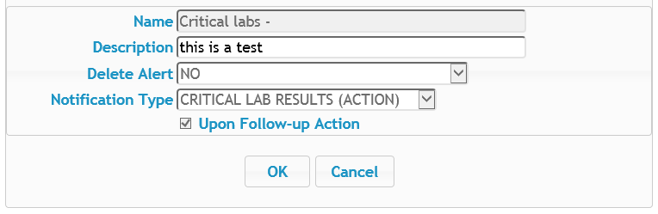
Alert Categories
A programmer security key is required to add, delete, and fully edit alert categories.
Without a programmer key, only the Description field can be edited. To do so, type directly into in the Description field.
The description must be 3-40 alphanumeric characters in length.
Click OK to save your changes.
KB Editor Alert Category Details

Slide 32
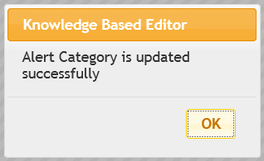
Alert Categories
You will see the following message if the update was successful. Click OK to proceed.
KB Editor Alert Category Update Confirmation Message
The Description field will then be updated in the alert category list.
KB Editor View Alert Categories Tab

Slide 33
Alert Types

Slide 34
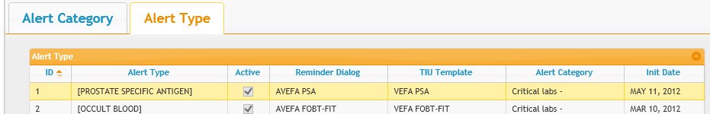
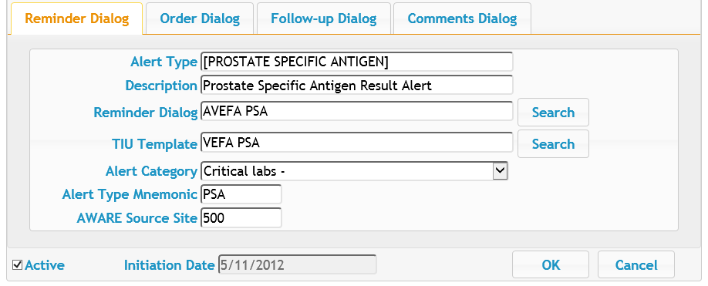
Alert Types
Double-click on a row or press Ctrl+Alt+E with a row highlighted to view detailed information about an alert type.
KB Editor View Alert Types Tab
KB Editor Alert Type Details

Slide 35
Alert Types
Before adding, editing, or deleting alert types, note:
Understanding the alert types associated with the VistA Reminder Dialog, along with site-specific alert types, is critical to having a meaningful and well-defined alert type.
Knowledge of Reminder Dialogs, Text Integration Utilities (TIU), and Health Factors design are also essential.
Only CACs should create and maintain Alert Type records.

Slide 36
Adding Alert Types

Slide 37
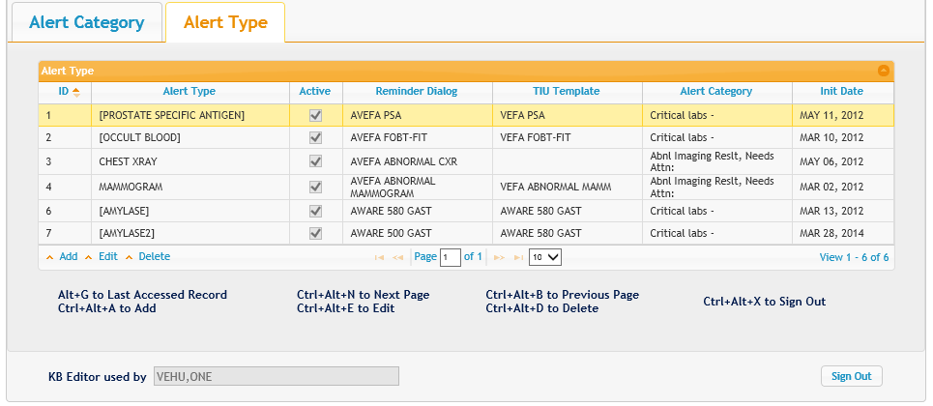
Adding Alert Types
First, click on the Add button or press Ctrl+Alt+A to start adding a new alert type.
Note: An alert category must be defined first before creating alert types within it.
KB Editor View Alert Types Tab

Slide 38
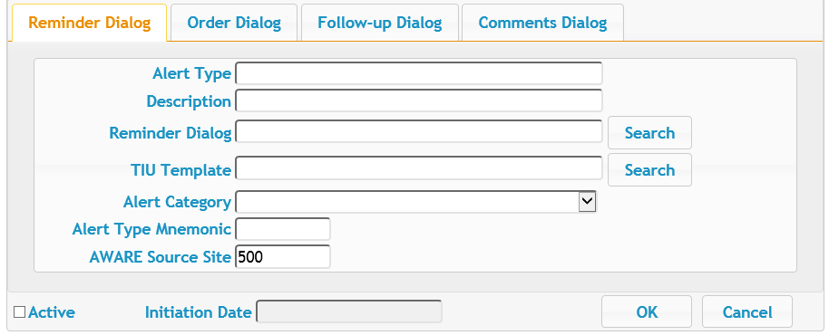
Adding Alert Types
The Alert Type Details page will appear, with four tabs:
Reminder Dialog
Order Dialog
Follow-up Dialog
Comments Dialog
Note: The tabs can be filled out in any order.
KB Editor View Alert Type Details

Slide 39
The Reminder Dialog

Slide 40
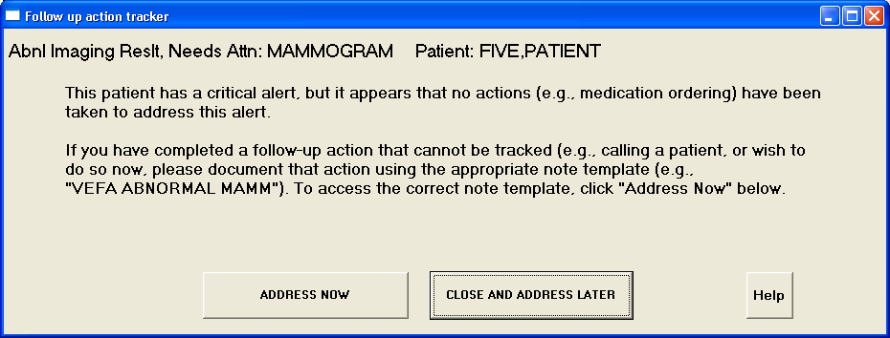
The Reminder Dialog
In the Reminder Dialog tab you will configure how the alert type functions. This includes settings such as the alert type’s name, what prompt will appear to the provider at the start of the AWARE Alert Tracker process.
Note: For further information about the AWARE Alert Tracker, see the separate training document, AWARE Alert Tracker Training.
An AWARE Alert Tracker Prompt

Slide 41
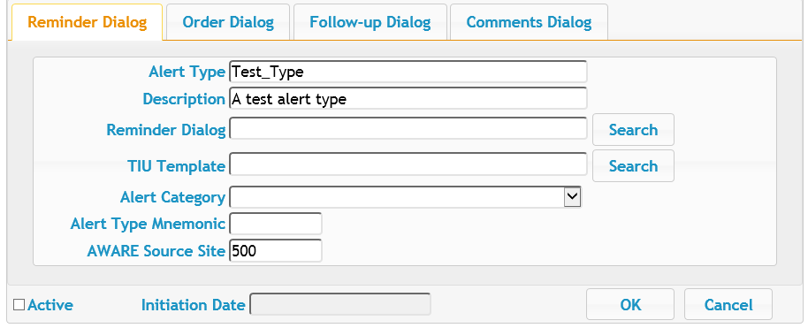
The Reminder Dialog
Begin filling out the fields on the Reminder Dialog tab by entering the Alert Type and a description.
Note: For a description of what each field represents, see the slide Understanding the Columns – Alert Type Tab.
KB Editor View Alert Type Details – Reminder Dialog tab

Slide 42
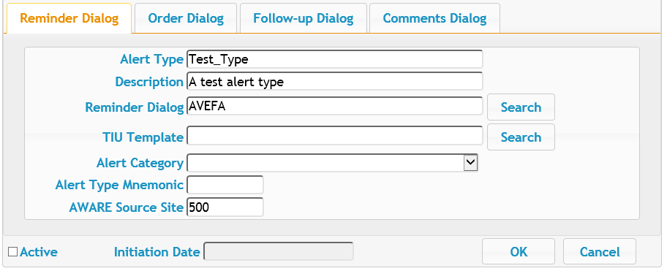
The Reminder Dialog
To fill out the Reminder Dialog and TIU Template fields, you must conduct a search. Enter the text to search in the field and then press the Search button.
Note: The Search is case-sensitive, so make sure to enter capital letters if searching for items such as VEFA/AVEFA/AW500, etc.
KB Editor View Alert Type Details – Reminder Dialog tab

Slide 43
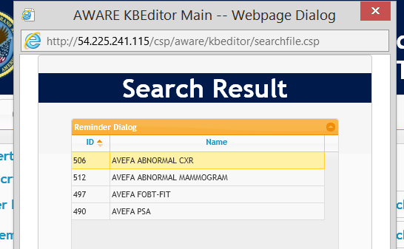
The Reminder Dialog
A window will appear displaying the search results. Double-click on a result to select it. Alternatively, click on a result to highlight it, and then press Enter.
KB Editor Search Result Window

Slide 44
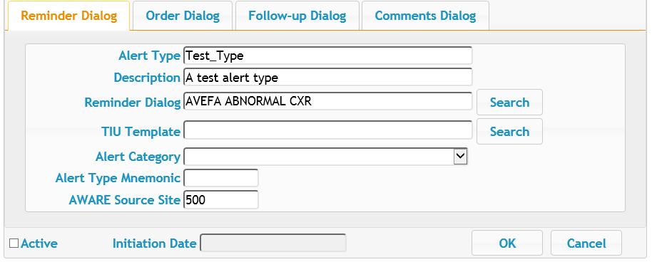
The Reminder Dialog
The search result you selected will then be entered into the field on the previous page.
KB Editor View Alert Type Details – Reminder Dialog tab

Slide 45
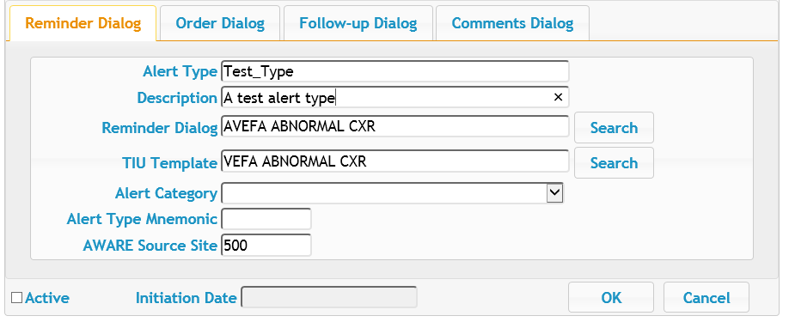
The Reminder Dialog
Fill out the TIU Template field by conducting another search.
KB Editor View Alert Type Details – Reminder Dialog tab

Slide 46
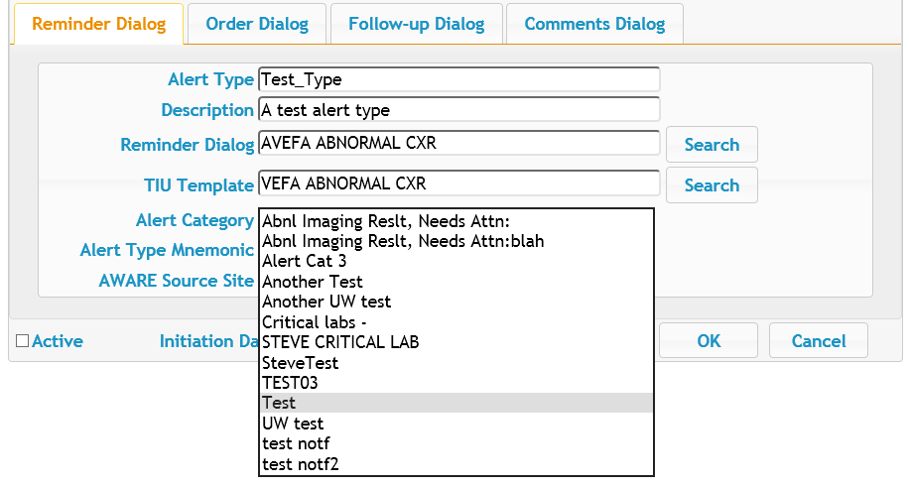
The Reminder Dialog
Select an alert category using the dropdown.
KB Editor View Alert Type Details – Reminder Dialog tab

Slide 47
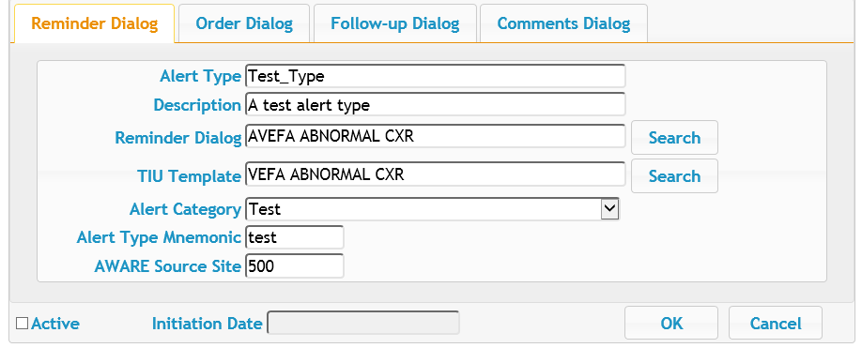
The Reminder Dialog
Enter an Alert Type Mnemonic and AWARE Source Site. The AWARE Source Site should be your own site station number.
KB Editor View Alert Type Details – Reminder Dialog tab

Slide 48
The Reminder Dialog
Now that you are finished entering information in the Reminder Dialog tab, proceed to the next tab by clicking on the Order Dialog tab.
KB Editor View Alert Type Details – Reminder Dialog tab

Slide 49
The Order Dialog

Slide 50
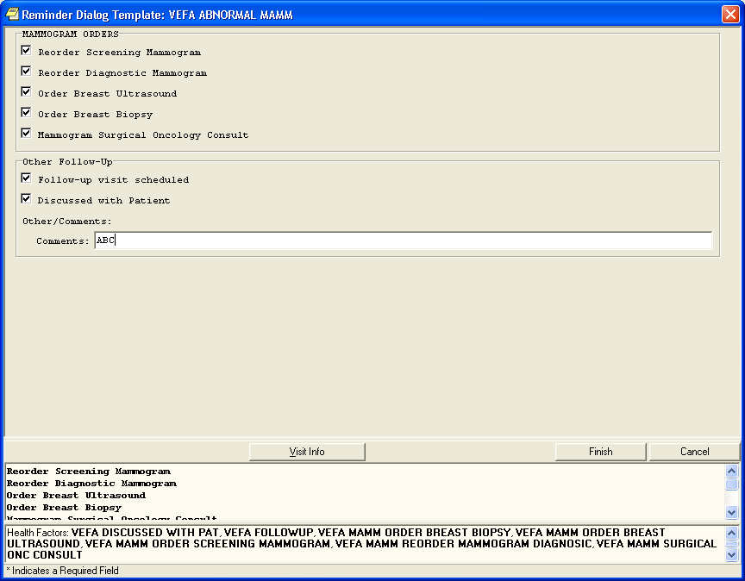
The Order Dialog
On the Order Dialog tab you will configure which orders will appear to the provider that they can select from when creating a follow-up action note at the end of the AWARE Alert Tracker process.
Note: For further information about the AWARE Alert Tracker, see the separate training document, AWARE Alert Tracker Training.

Slide 51
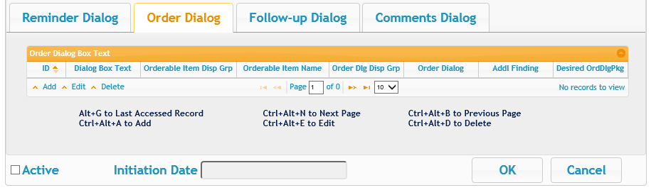
The Order Dialog
The Order Dialog tab will begin blank. Orders need to be added.
To begin adding orders, click the Add button or press Ctrl+Alt+A.
KB Editor View Alert Type Details – Order Dialog tab

Slide 52
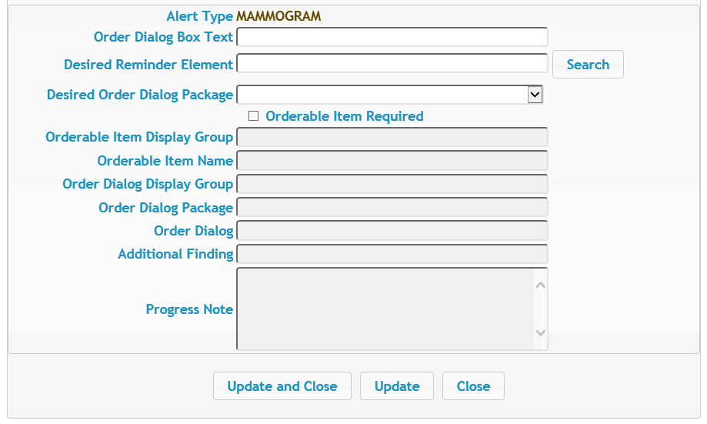
The Order Dialog
A page will appear where you can create an order to add to this alert type.
KB Editor View Alert Type Details – Order Creation Tab

Slide 53
Understanding the Order Creation Tab Fields
The table below describes what each field on the Order Creation Tab corresponds to:
Alert Type | Indicates the alert type for information only.
Order Dialog Box Text | Gives CACs guidance to update the dialog element’s Dialog/Progress Note field with similar text.
Desired Reminder Element | The dialog element for the Reminder. Gives CACs guidance to create a similar dialog element in the Reminder Dialog file.
Desired Order Dialog Package | Indicates the Order Dialog package associated with the dialog element. Gives CACs guidance to use a similar package when constructing the dialog element in the Reminder Dialog file.
Orderable Item Required | If checked, indicates that the Orderable Item is required for this dialog element.
Orderable Item Display Group | Indicates the Display Group that the orderable item is a member of.
Orderable Item Name | Indicates the Orderable item name for the dialog element.
Order Dialog Display Group | Indicates the Display Group of dialog element’s Finding Item.
Order Dialog Package | Indicates the package of dialog element’s Finding item.
Order Dialog | Indicates the dialog element’s Finding Item field.
Additional Finding | Indicates the additional finding that should be posted for this dialog element.
Progress Note | Displays the progress note attached to the dialog element.
Note: The fields below Orderable Item Required are blank until the order is created.
KB Editor View Alert Type Details – Order Creation Tab Field Descriptions

Slide 54
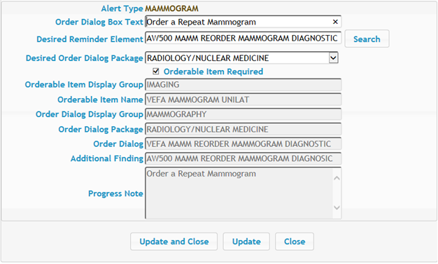
The Order Dialog
Proceed through the fields, entering the appropriate information. Stop when you reach the Orderable Item Required checkbox.
Click Update to create the order. The fields below the Orderable Item Required checkbox will automatically populate.
Note: The Update and Close button will save the order and return you to the Order Dialog tab.
KB Editor View Alert Type Details – Order Creation Tab

Slide 55
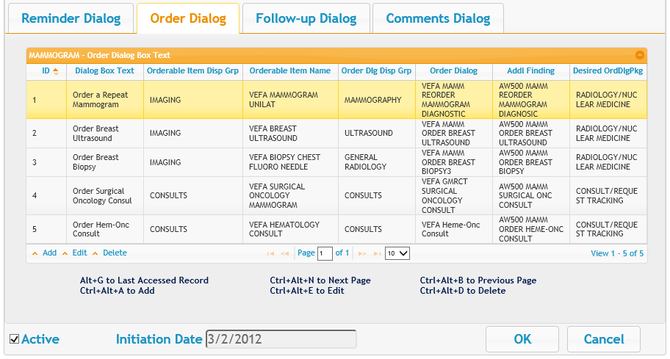
The Order Dialog
The orders you create will be displayed in the Order Dialog tab as shown below.
Note: Created orders can be edited or deleted. Editing and deleting orders is similar to editing or deleting alert types. For more information, see Editing Alert Types or Deleting Alert Types.
KB Editor View Alert Type Details – Order Dialog Tab

Slide 56
The Order Dialog
Now that you are finished entering information in the Order Dialog tab, proceed to the next tab by clicking on the Follow-up Dialog tab.
KB Editor View Alert Type Details – Follow-up Dialog tab

Slide 57
The Follow-up Dialog

Slide 58
The Follow-up Dialog
On the Follow-up Dialog tab you will configure which follow-up actions (that are not orders) providers can select when creating a follow-up action note at the end of the AWARE Alert Tracker process.
Note: For further information about the AWARE Alert Tracker, see the separate training document, AWARE Alert Tracker Training.

Slide 59
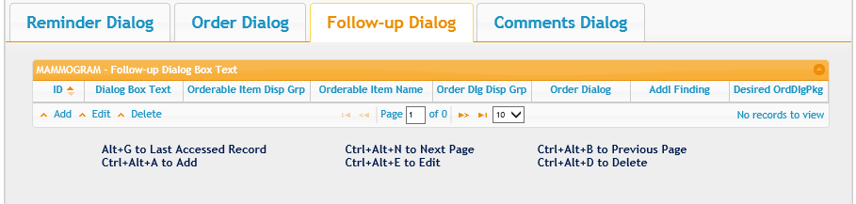
The Follow-up Dialog
Like the Order Dialog tab, the Follow-up Dialog tab will begin blank. Orders need to be added.
To begin adding follow-up actions, click the Add button or press Ctrl+Alt+A.
KB Editor View Alert Type Details – Follow-up Dialog tab

Slide 60
The Follow-up Dialog
A page will appear where you can create follow-up actions to add to this alert type.
Note: This page is identical to the Order Creation Tab and the fields correspond to the same items. For more information, see Understanding the Order Creation Tab Fields.
KB Editor View Alert Type Details – Follow-up Creation Tab

Slide 61
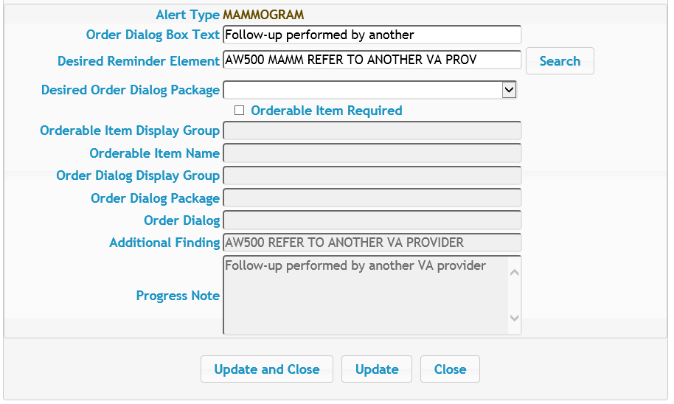
The Follow-up Dialog
Proceed through the fields, entering the appropriate information. Stop when you reach the Orderable Item Required checkbox.
Click Update to create the follow-up action. The fields below the Orderable Item Required checkbox will automatically populate.
Note: The Update and Close button will save the follow-up action and return you to the Follow-up Dialog tab.
KB Editor View Alert Type Details – Follow-Up Creation Tab

Slide 62
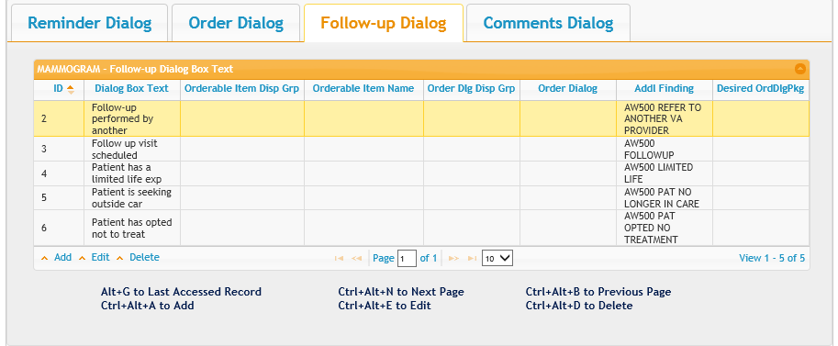
The Follow-up Dialog
The follow-up actions you create will be displayed in the Follow-up Dialog tab as shown below.
Note: Created follow-up actions can be edited or deleted. Editing and deleting follow-up actions is similar to editing or deleting alert types. For more information, see Editing Alert Types or Deleting Alert Types.
KB Editor View Alert Type Details – Follow-up Dialog Tab

Slide 63
The Follow-up Dialog
Now that you are finished entering information in the Follow-up Dialog tab, proceed to the next tab by clicking on the Comments Dialog tab.
KB Editor View Alert Type Details – Follow-up Dialog tab

Slide 64
The Comments Dialog

Slide 65
The Comments Dialog
On the Comments Dialog tab you will configure the field where providers can choose to enter free-form comments when creating a follow-up action note at the end of the AWARE Alert Tracker process.
Note: For further information about the AWARE Alert Tracker, see the separate training document, AWARE Alert Tracker Training.

Slide 66
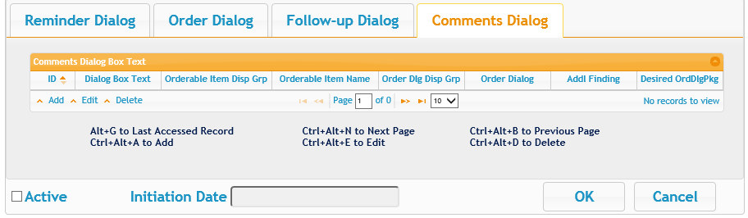
The Comments Dialog
Like the Follow-up Dialog tab, the Comments Dialog tab will begin blank. Comments options need to be added.
To begin adding comments options, click the Add button or press Ctrl+Alt+A.
KB Editor View Alert Type Details – Comments Dialog tab

Slide 67
The Comments Dialog
A page will appear where you can create comments options to add to this alert type.
Note: This page is identical to the Order Creation Tab and the fields correspond to the same items. For more information, see Understanding the Order Creation Tab Fields.
KB Editor View Alert Type Details – Comments Option Creation Tab

Slide 68
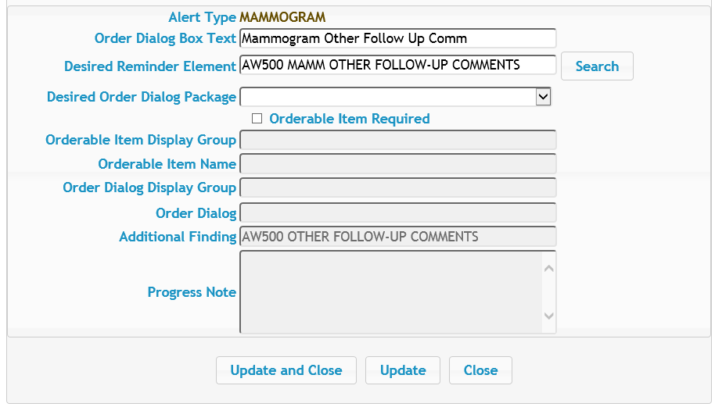
The Comments Dialog
Proceed through the fields, entering the appropriate information. Stop when you reach the Orderable Item Required checkbox.
Click Update to create the follow-up action. The fields below the Orderable Item Required checkbox will automatically populate.
Note: The Update and Close button will save the comments option and return you to the Comments Dialog tab.
KB Editor View Alert Type Details – Comments Option Creation Tab

Slide 69
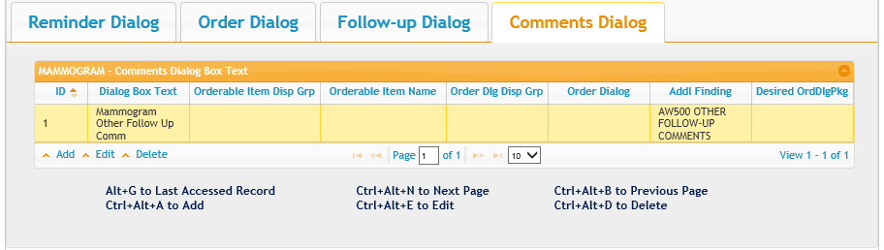
The Comments Dialog
The comments options you create will be displayed in the Comments Dialog tab as shown below.
Note: Created comments options can be edited or deleted. Editing and deleting comments options is similar to editing or deleting alert types. For more information, see Editing Alert Types or Deleting Alert Types.
KB Editor View Alert Type Details – Comments Dialog Tab

Slide 70
Making Alerts Active

Slide 71
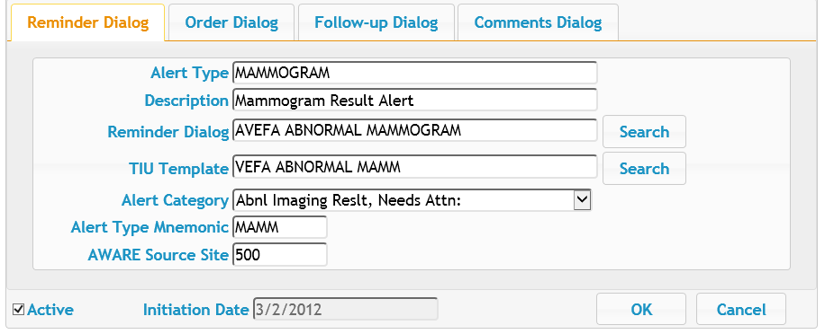
Making Alerts Active
To begin using the new alert type you have created, you need to set the alert type as Active using the checkbox and click OK.
You should not make an alert type Active until the Reminder Dialog has been completely designed and customized for your site.
Note: Marking the alert type as Active will set the Initiation Date to the current date. The Alert Type Validator may deactivate the Active flag if an error is found.
KB Editor View Alert Type Details – Reminder Dialog Tab

Slide 72
Editing Alert Types

Slide 73
Editing Alert Types
Editing an existing alert type works in a similar fashion to adding a new alert type.
To start editing an alert type, first double-click on an alert type. Alternatively, you can click on the Edit button or press Ctrl+Alt+E with a row highlighted.
KB Editor View Alert Types Tab

Slide 74
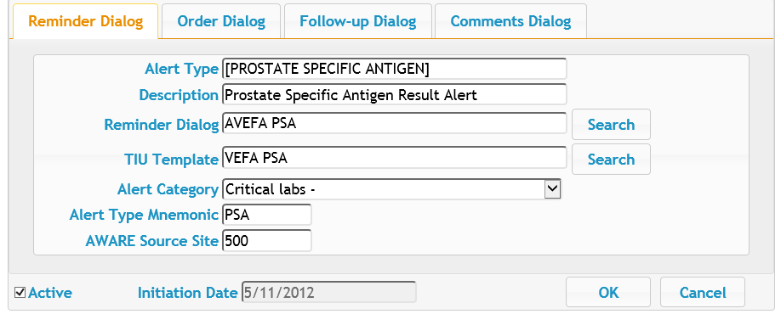
Editing Alert Types
The Alert Type Details page will appear.
Proceed through the fields and tabs, updating the alert type as appropriate. For more information, see Adding Alert Types.
When you are finished, click OK to save your changes.
KB Editor View Alert Type Details

Slide 75
Deleting Alert Types

Slide 76
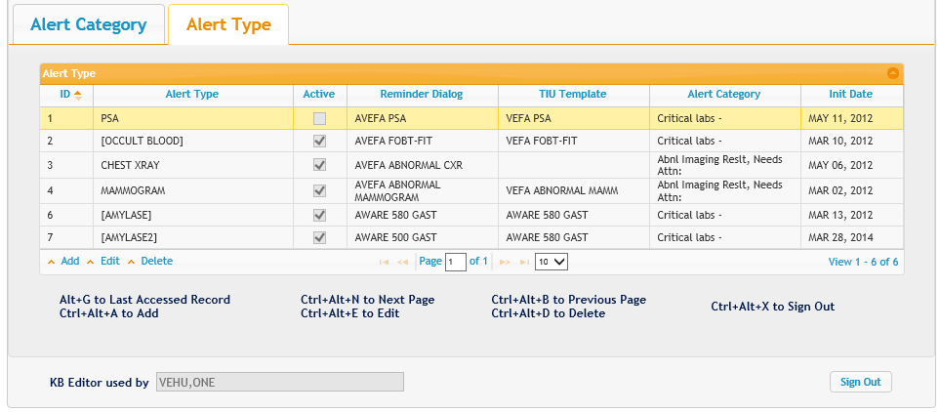
Deleting Alert Types
To delete an alert type, click on an alert type to highlight it, then click Delete or press Ctrl+Alt+D.
KB Editor View Alert Types Tab

Slide 77
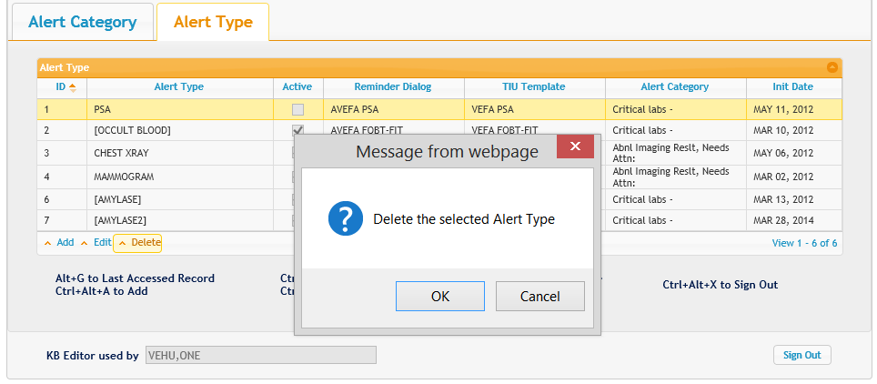
Deleting Alert Types
A warning message will appear. Click OK to delete the alert type or Cancel to abort.
KB Editor Alert Type Deletion Warning Message

Slide 78
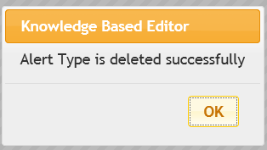
Deleting Alert Types
After clicking OK, the alert type will be deleted and a confirmation message will be displayed.
Click OK to return to the Alert Types tab.
KB Editor Alert Type Deletion Confirmation Message

Slide 79
Contact Information

Slide 80
Contact Information
If you have questions or need additional assistance, contact:
CAC Support:
Margaret Fralin (Margaret.Fralin@va.gov)
Patrick McGillicuddy (Patrick.McGillicuddy@va.gov)
AWARE Technical Support:
awarespprt@gmail.com

